Slide 1
Meal Nutrition Analysis
Integrating Sensing Data, Images, and Micro Gut Health
Mahima Bhatt, Ellika Mishra, Yash Honrao

Slide 2
Introduction
Importance of understanding calorie consumption.
Motivation for using multimodal data.
Dataset: 40+ participants, up to 10 days of data.
Goal: Build a robust model to estimate lunch calories.

Slide 3
Background
Current methods rely on single modalities.
Multimodal learning combines diverse data for better accuracy.
Challenges: Heterogeneous data, missing entries.

Slide 4
Methods
Model Architecture:
LSTM for sequential data.
Dense layers for demographics and health data.
Image features integrated.
Attention mechanism and residual connections.
Hyperparameter Tuning: Learning rates, layers, dropout.

Slide 5
Dataset Preparation
Preprocessing:
Normalized numerical data.
Augmented images: rotation, zoom, flips. (future scope)
Padded sequence data for CGM time series.
Data Splits: 80:20 (Train : Validation).

Slide 6
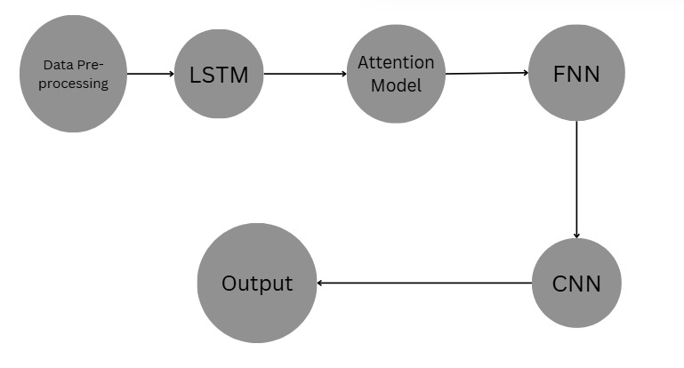
Architecture

Slide 7
Training and Testing
Training:
Adam optimizer, learning rate = 0.01.
Batch size = 32, epochs = up to 1000.
Early stopping and learning rate reduction.
Testing:
Metrics: MSE, MAE, R² score.

Slide 8
Results and Evaluation
Model Performance:
MSE = 75.32, MAE = 6.89 (example values).
Outperformed singlemodality models by 20%.
Qualitative Analysis:
Attention weights highlighted key features.

Slide 9
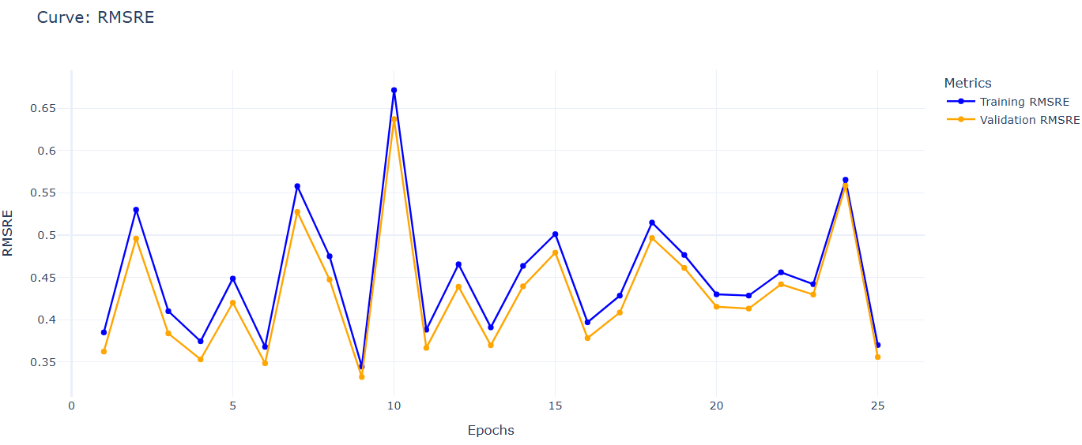
RMSRE Curve
Batch Size – 32
Learning Rate – 0.01
Weight Decay - 1e-5
Optimizer - Adam

Slide 10
Challenges Faced
Missing data and variability across participants.
High computational demands.
Balancing complexity with interpretability.

Slide 11
Conclusion
Key Findings:
Multimodal models improve accuracy.
Captured interactions between features.
Future Work:
Expand dataset for diversity.
Finetune model for realtime prediction.

